Slide 1
Unit 1
Chapter 1
Lessons 2-3
Text pages 18-25

Slide 2
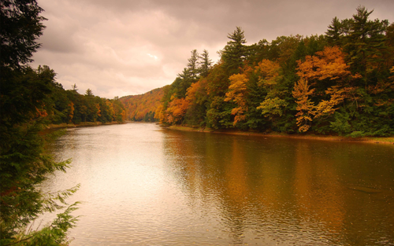
Please Do Now!
Make a list of things found in nature that people can use.
Share your list with your partner.

Slide 3
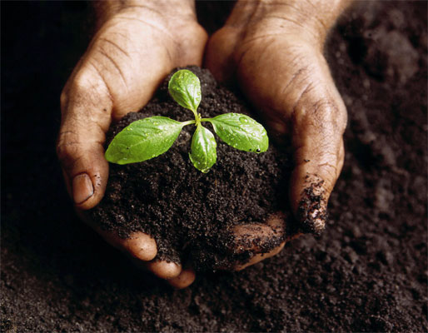
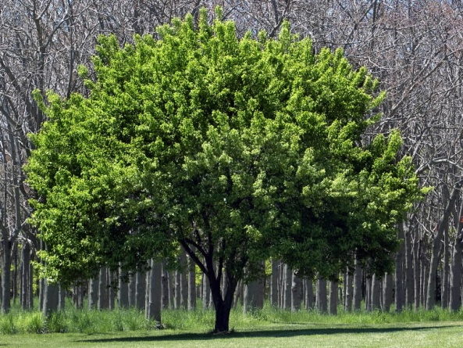
Natural resources are materials found in nature that people can use.
Trees
Soil
Water

Slide 4
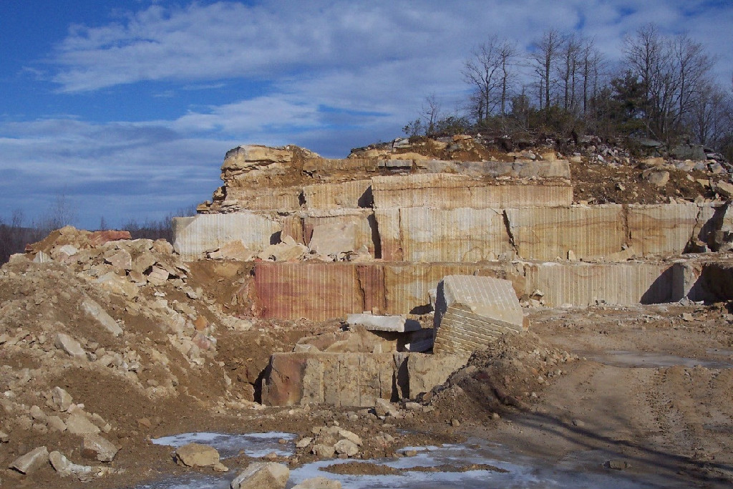
Sandstone found in Monroe county is used to make glass.

Slide 5
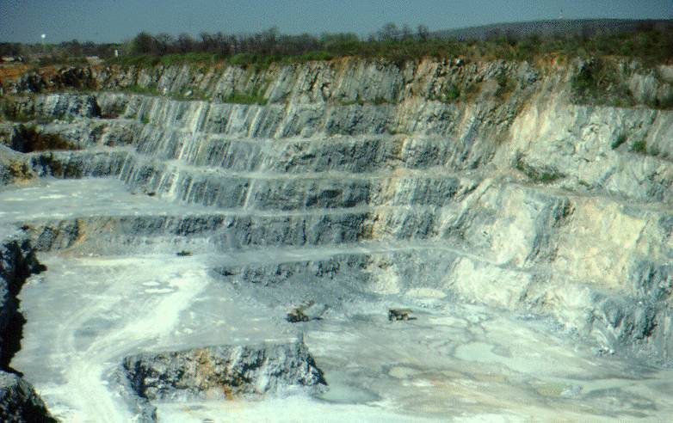
Limestone found in Pennsylvania is used to make building stone and cement.

Slide 6
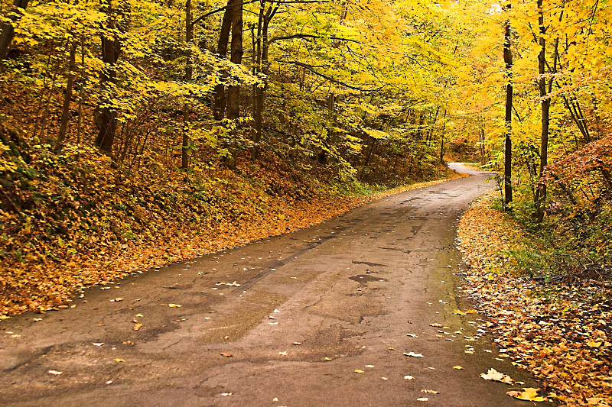
Vegetation may vary in different locations.

Slide 7
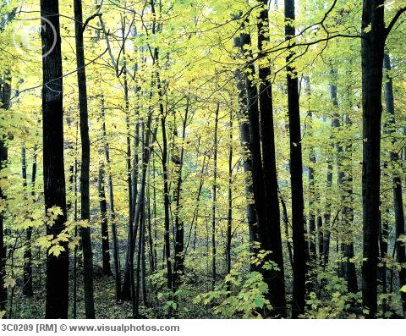
Hardwoods (oak, ash, elm, maple, and hickory) grow well in valleys and lowlands.

Slide 8
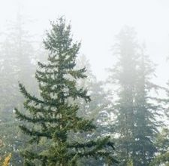
Softwoods (white pine and hemlock) grow in mountainous areas.

Slide 9
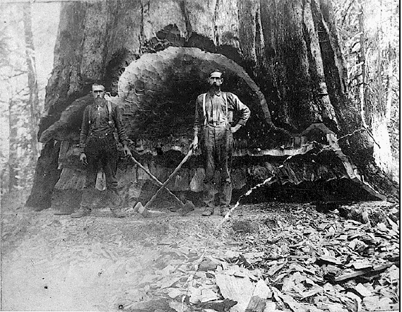

Slide 10
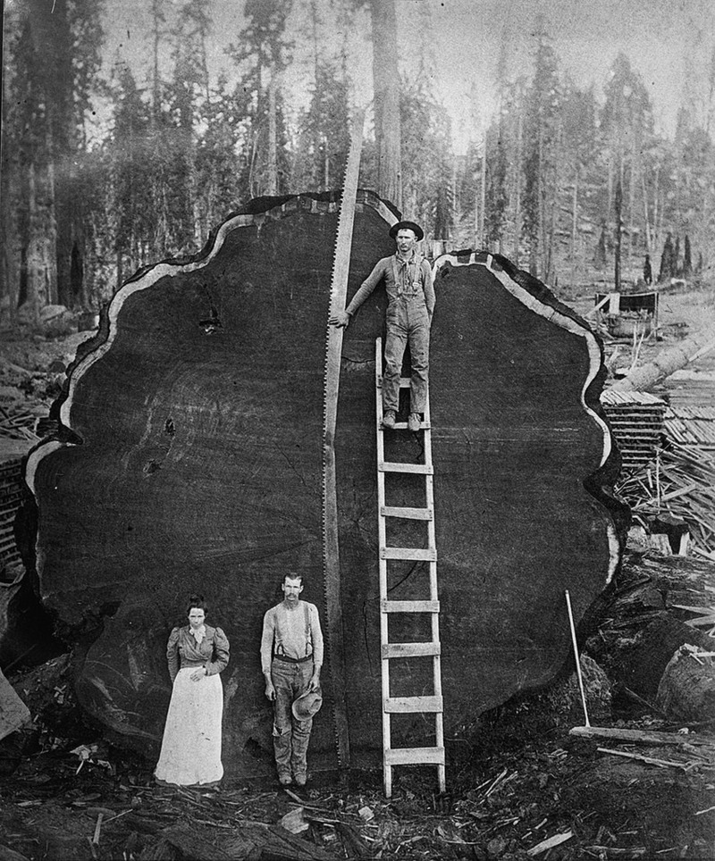

Slide 11
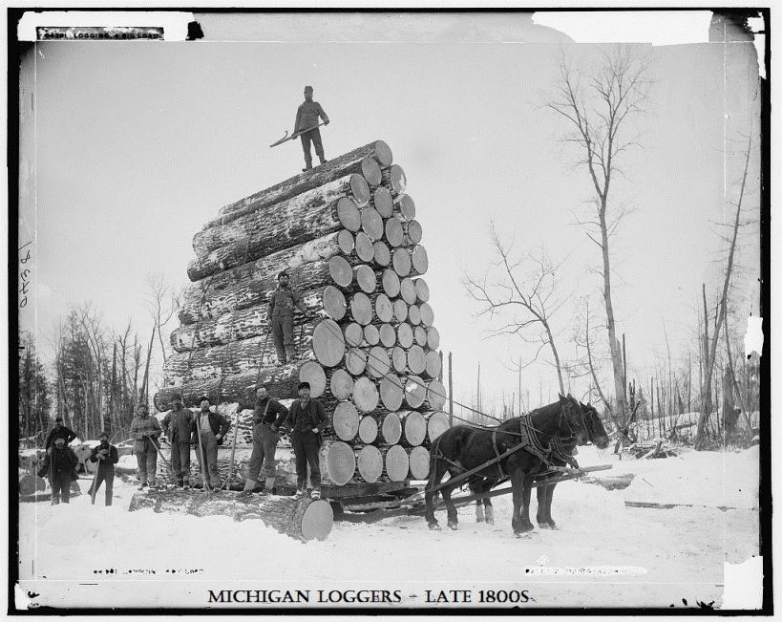

Slide 12
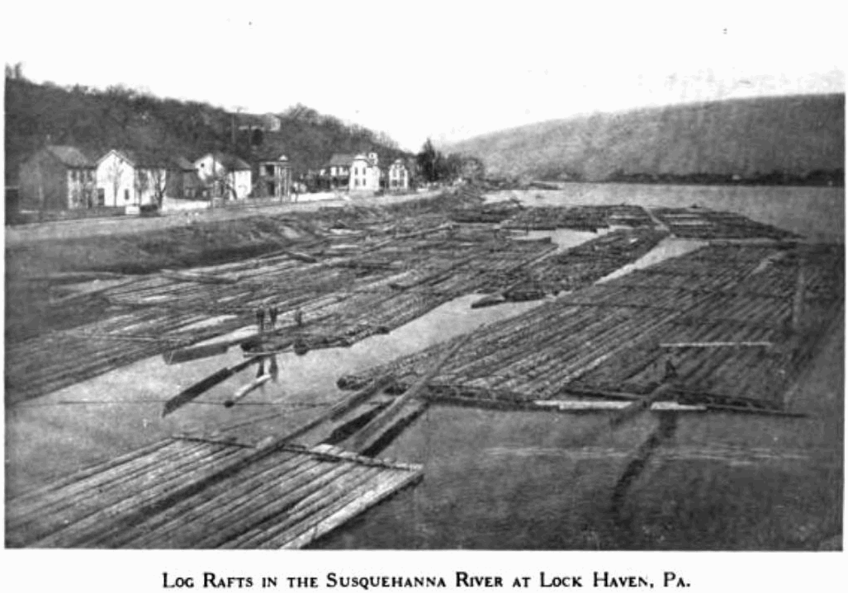

Slide 13
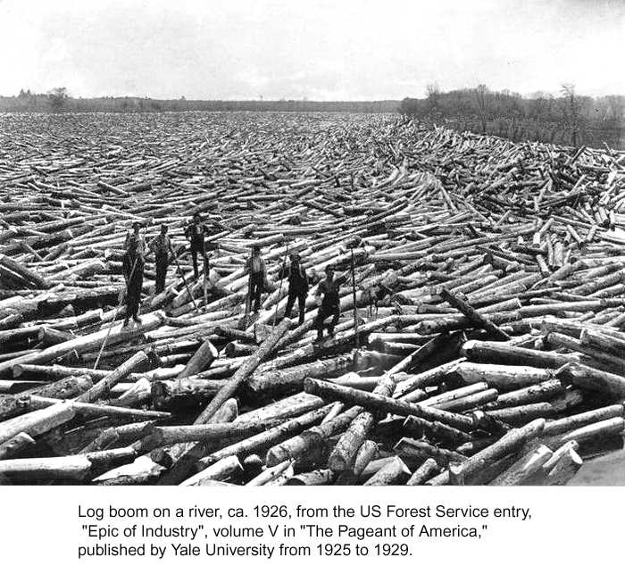

Slide 14
There are many different kinds of habitats in Pennsylvania that provide homes for a multitude of animals.

Slide 15
Weather changes day to day, even hour to hour. But climate is the pattern of weather in a place
over a long period of time.

Slide 16
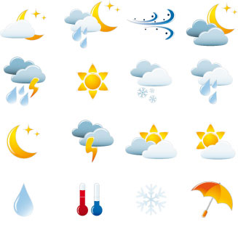
Pennsylvania has a temperate climate. It doesn’t get extremely hot or cold.

Slide 17
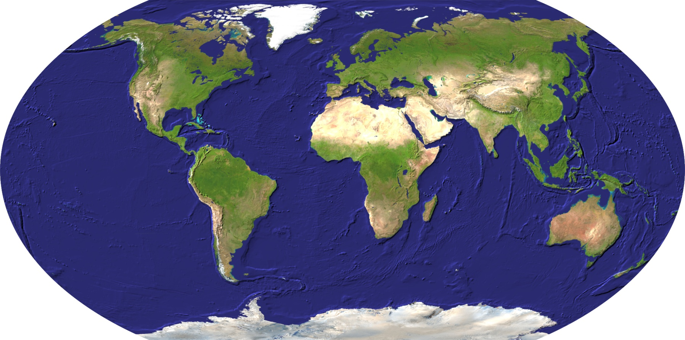
Pennsylvania’s location on Earth affects its climate.

Slide 18
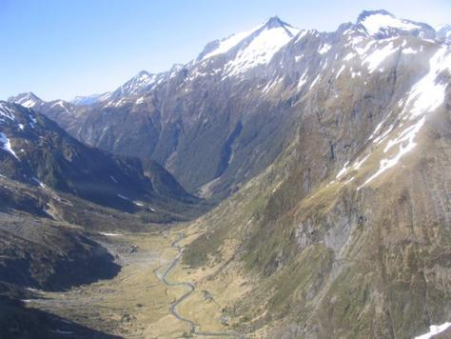
Elevation also affects the climate in an area.

Slide 19
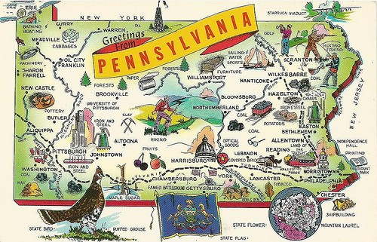
Exit Question
How do you think Pennsylvania’s natural resources have influenced people over the years.
Share with a partner.

